Slide 1
Universal Lens Presented by: Andromeda Cartographers
Problem:
NASA researchers have massive FITS images too large for average computers
AI can help with categorization but human verification is essential
Time-consuming process requiring specialized NASA hardware access

Slide 2
Solution proposed:
Web app that breaks large images into smaller tiles
Google Maps-style navigation (zoom, pan)
"Find the object" game for public users
Human categorization compared to AI pattern findings
Collected human data for added analysis
BorderLine Science DNA

Slide 3
Key Features:
Save coordinates with notes and categorization
Load progress -> finding patterns found by the ai
Free to use for both researchers and users.
The solution is expandable to multiple fields and has the opportunity to grow.

Slide 4
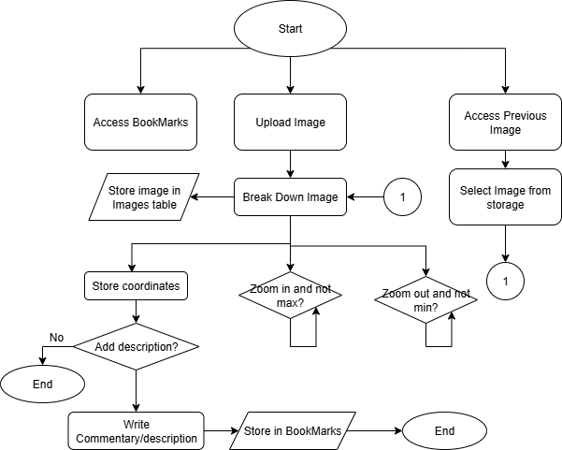

Slide 5
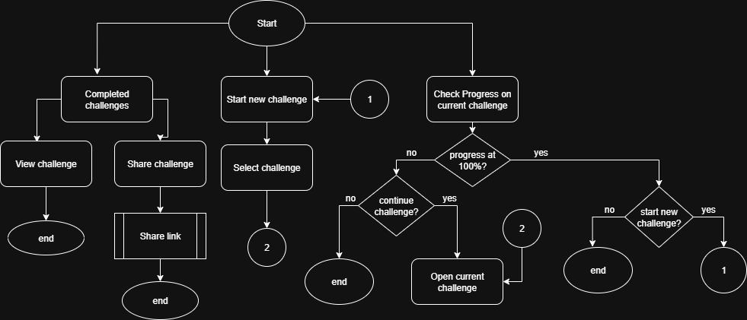

Slide 6
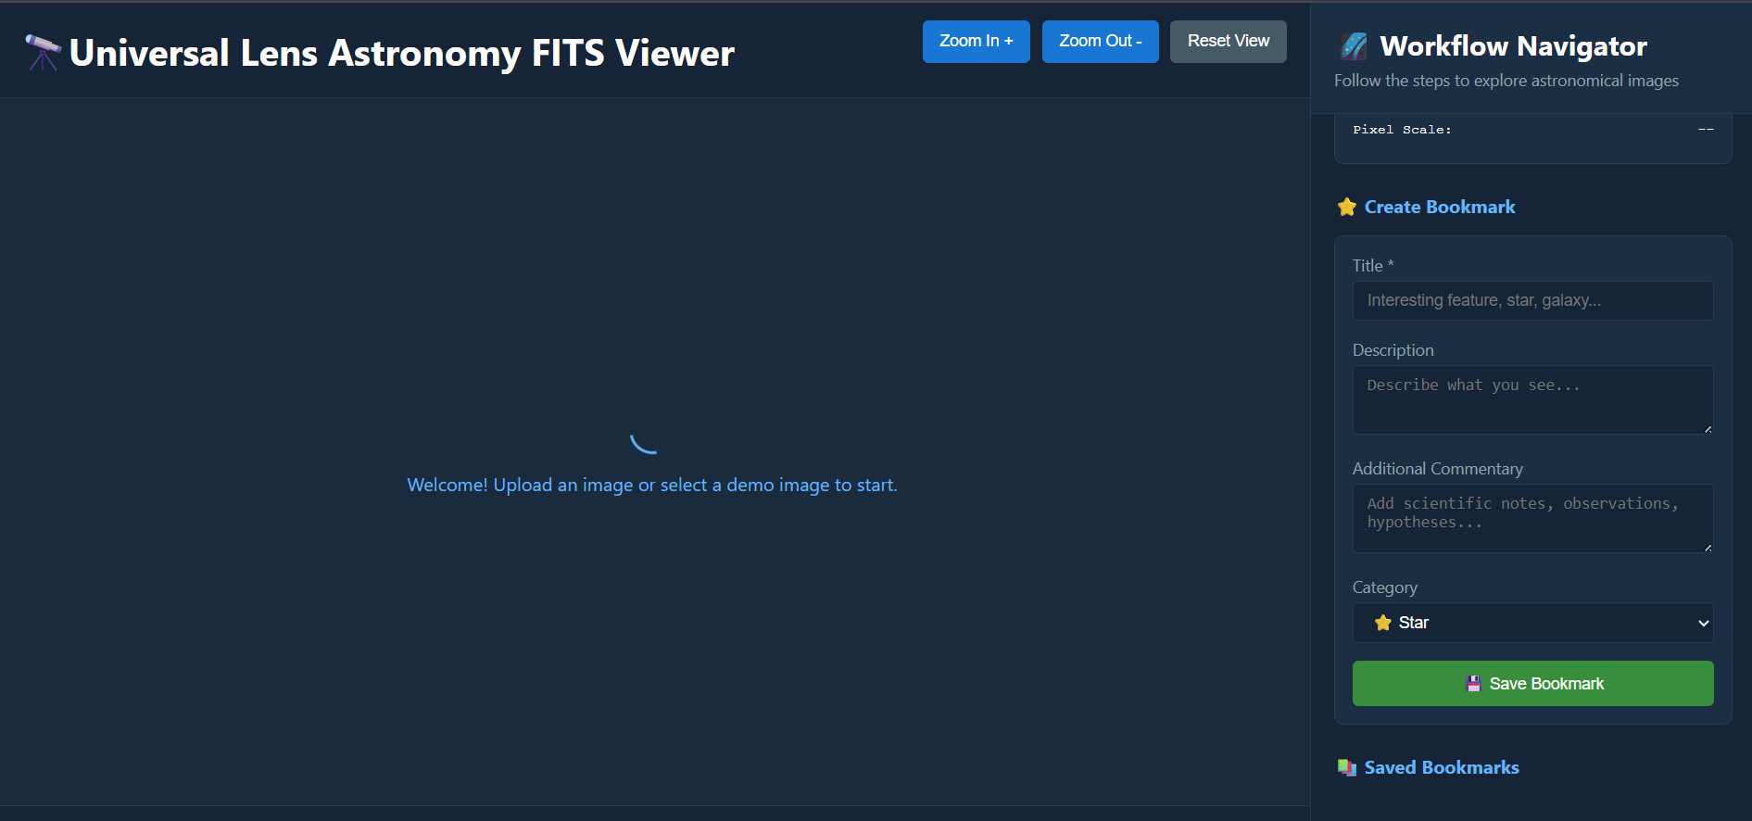

Slide 7
Future Implementations:
Same solution can be adapted to different fields
Potential uses in the future
Medical filed: microscope images or high-resolution medical scans
Arts and Cultures field: allows for authentication or pattern study on ancient objects of civilization, fossils etc..
…open to many more fields.

